Slide 1

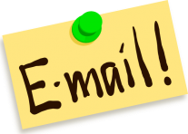
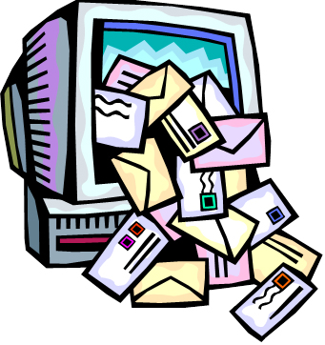
Email Etiquette and Professionalism
Dr. Steve Broskoske
Misericordia University

Slide 2
Email Etiquette
Email is a major way that professionals communicate.
Although we communicate informally with friends through text, email, and message on various services (such as Facebook and Snapchat), using any media of online communication with professionals is different!

Slide 3

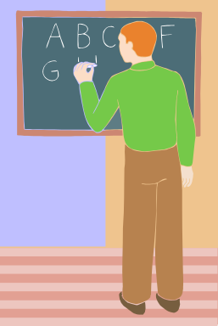

Email Etiquette
Every time you communicate with another professional (MU faculty member, K-12 teacher, principal, etc.), you are making a professional statement and creating a picture of yourself.
OR

Slide 4
How to Begin
Begin an email with an appropriate greeting, as you would if you were preparing a letter.
Dear Dr. Loughlin:

Slide 5
Descriptive Subject Line
What is your email message going to be about? Compose an appropriate, descriptive subject line:
  Question
  URGENT Question
  Request to Complete Field Experience

Slide 6

Keep It to the Point
Keep your email short and to the point.
  Takes more work to type a short, succinct message than it does to type a long message. Be brief and to the point.

Slide 7
Respect Your Relationship
Make your tone appropriate to your relationship with the receiver:
  Are you close to the receiver (have a personal relationship)?
  Have you ever met this person before?
Use phrases and words appropriate to your relationship:
  Avoid being too close too soon: “Hey, Bud!”
  Avoid using acronyms: LOL, LMAO.

Slide 8

Remember the Attachment
HINT: When typing, if you refer to an attachment, stop typing and immediately attach the file.
There is nothing more embarrassing than forgetting to attach a file, and having to resend an “oops” message.

Slide 9
Describe the Attachment
If you add an attachment, describe what it is and/or why the receiver will want to view it.
If you are sending many attachments, consider creating a zip file (we will do this in mod 2).
If you forward a message, describe why you are sending this to the receiver.

Slide 10
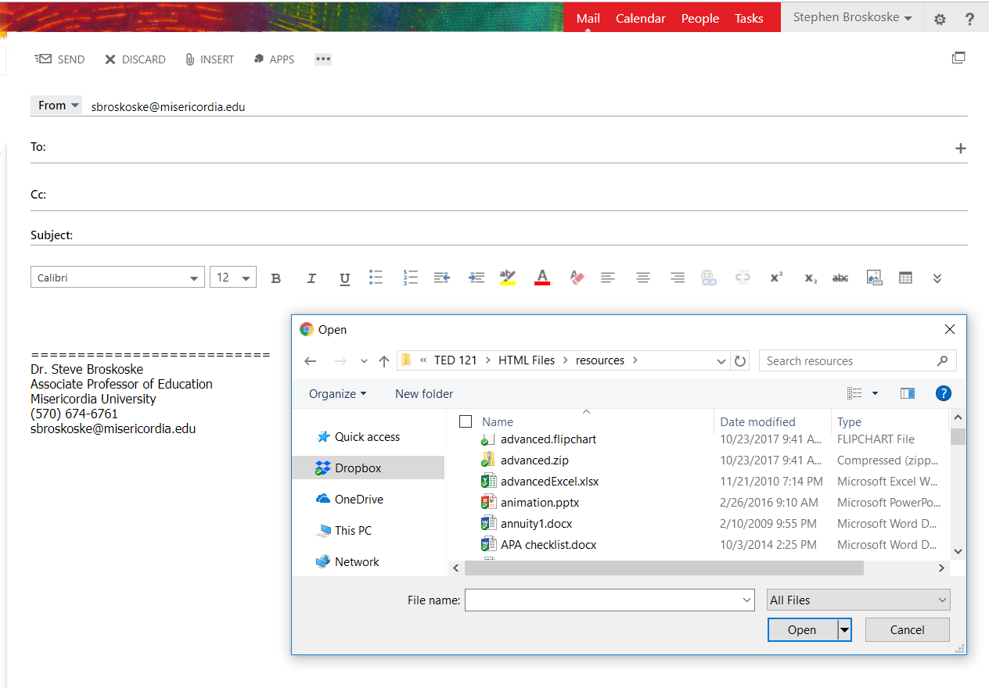
Adding the Attachment

Slide 11
How to Close
Thank the receiver for their time (if appropriate).
Sign your name.
Consider creating a “signature file” that illustrates who you are and how to contact you.
----------------------------------
Steve Broskoske
Secondary Education Student
Misericordia University
email: xxxxxxx@misericordia.edu
phone: (xxx) xxx-xxxx

Slide 12


Spell Check
Remember that you are creating an impression as you prepare an email message.
Always spell check your message when sending an email in a professional capacity.

Slide 13
Setting Email Options
In Outlook email:
  Set a photo in email:
    Navigate to sent mail.
    Click the character next to your name to open profile.
    Add a photo of yourself.
  Set an email signature:
    Select the gear to open settings.
    In mail – composer and reply, set your email signature.
    Determine whether your signature automatically appears.

Slide 14
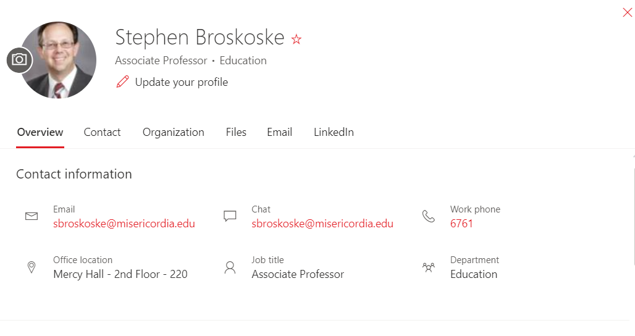
Email Options: Set Photo

Slide 15
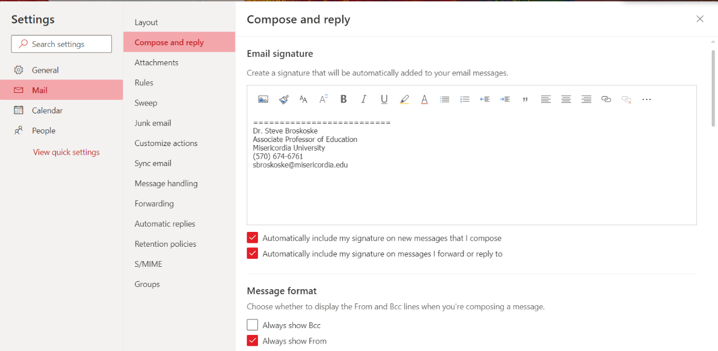
Email Options: Email Signature

Slide 16
Important Email Setting
People on campus report
not receiving email.
Accounts are set to focused
mode by Microsoft “to
present to you what the
machine believes is most important to you.”
Microsoft’s machine learning is not 100% accurate! This setting divides mail into two views: focused and other.

Slide 17
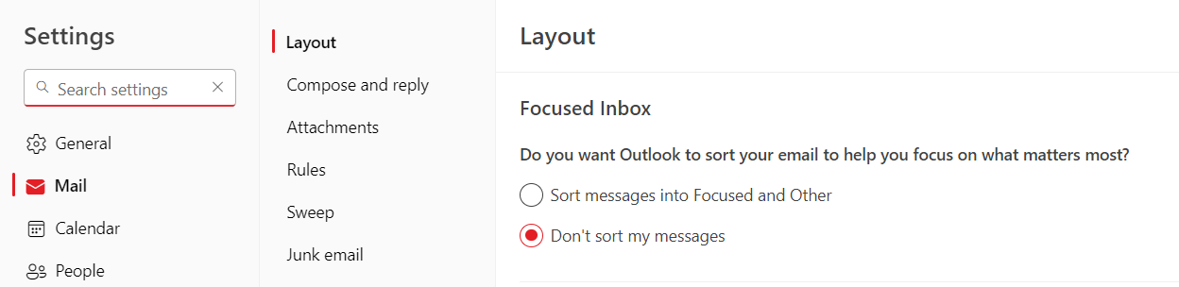
Important Email Setting
Click on settings gear icon.
Search for “focused inbox.”
Click to turn this feature off.

Slide 18
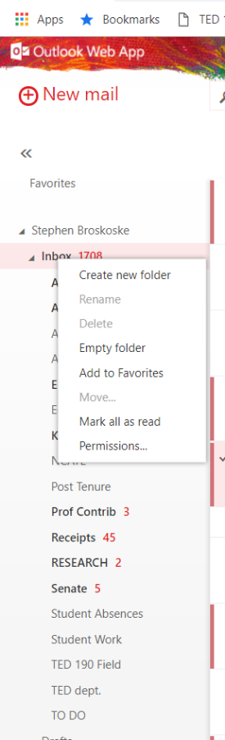
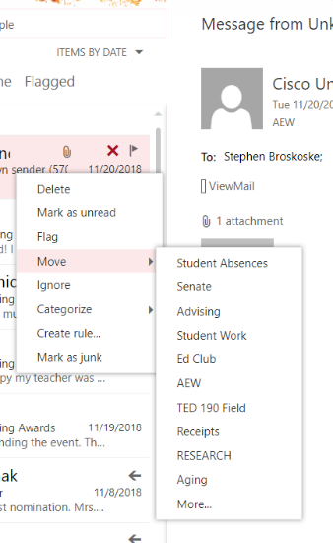
Organize Email

Slide 19
Summary
If you follow these simple email rules of etiquette, you will:
  Be respectful of the relationship you have with the receiver of the message.
  Create a positive impression of yourself to the receiver.
  Get more positive results from the messages you send.

